Slide 1
Adult Income Prediction
By Rajashree Mali

Slide 2
Problem Statement:
The Adult Occupation dataset aims to predict whether an individual’s income exceeds $50K per year based on demographic and employment-related attributes.
The objective is to analyze how various factors such as age, education, occupation, and work hours influence income levels, and to build a classification model that accurately predicts income categories for adults.
Key Features :
The information about the adults are: age, work class, education, marital status, occupation, relationship, race, gender, capital loss, hours per week, native country, income.
Dependent variable :
Income:- $50K per year based on demographic and employment-related attributes.

Slide 3
FLOW DIAGRAM
Data Collection
Data cleaning
Data Preprocessing
Model Data Frame1
Model Data Frame-2
Outlier
Class Imbalance
EDA
Feature selection
Model Dataframe-3
Model Validation

Slide 4
Data & cleaning:
Data contain 48,842 Observations and 16 Attributes.
Target Attribute:
Income
Checking the Missing Values
No Missing Value
Data type Conversion (Label Encoder)
Duplicate Checking
Data not having duplicate values.

Slide 5
Data Table 1:
Model Name | Accuracy | Precision | Recall | F1-Score
Logistic Reg | 78.564848 | 0.281369 | 0.628895 | 0.388792
Decision Tree | 80.908998 | 0.618927 | 0.603377 | 0.611053
Random Forest | 86.027229 | 0.627376 | 0.754573 | 0.685121
SVM | 79.445184 | 0.156738 | 0.968668 | 0.269818
KNN | 78.953834 | 0.137305 | 0.958702 | 0.240207
Naïve Bayes | 77.981370 | 0.228982 | 0.624424 | 0.335085
Conclusion : Random Forest is the top-performing model in terms of accuracy, precision, recall, and F1-score.

Slide 6
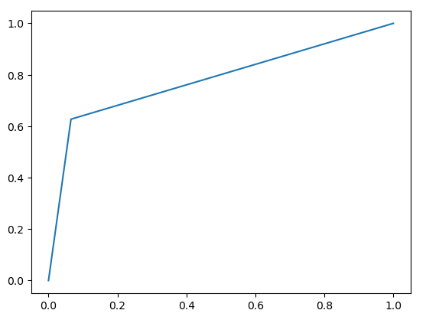
Graph of Best fitted model:
Best fitted model is Random Forest

Slide 7
EDA
Visualization
Class Imbalance
SMOTE
Outliers

Slide 8
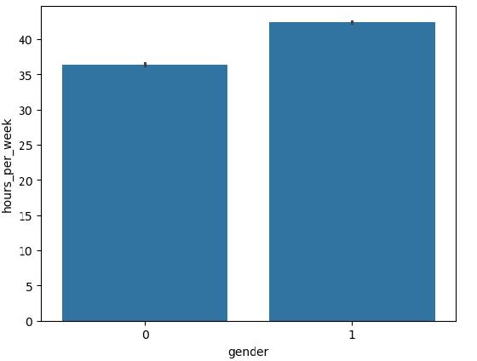
Visualization
Males works hours per week is greater than female .

Slide 9
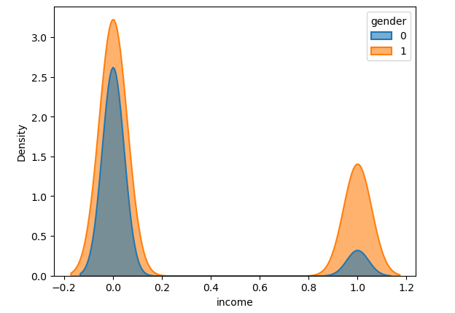
Male income is more than female

Slide 10
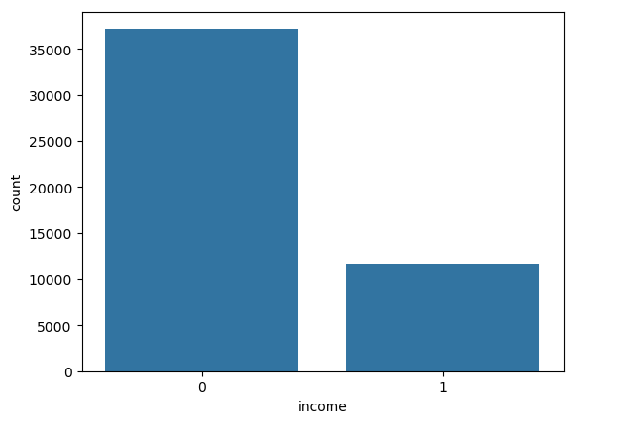
income 0 == <=50K is more than 1 means== >50K

Slide 11
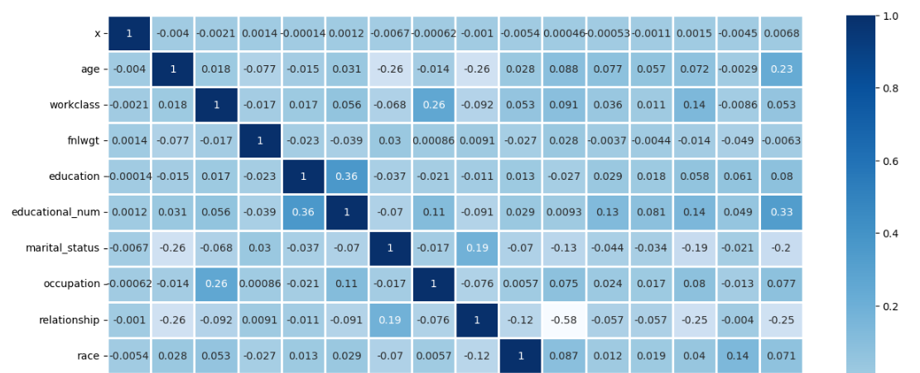
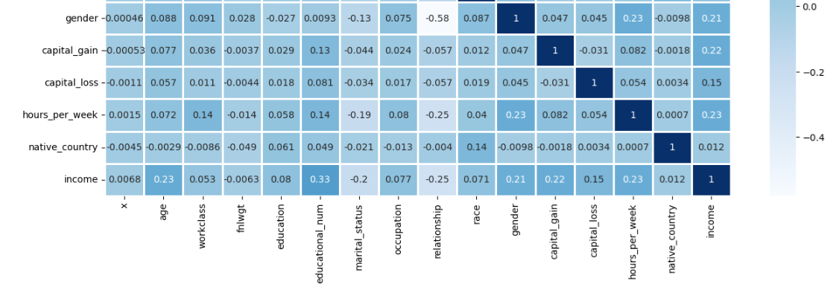

Slide 12
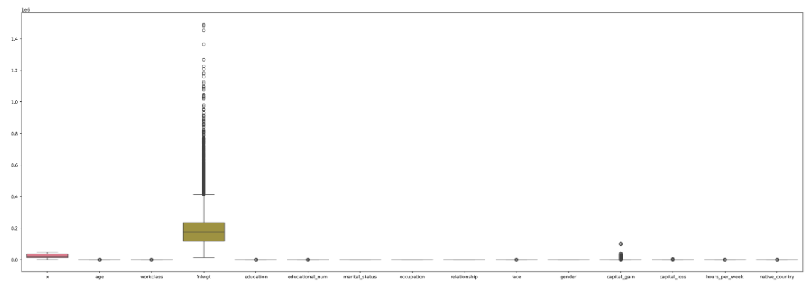

Slide 13
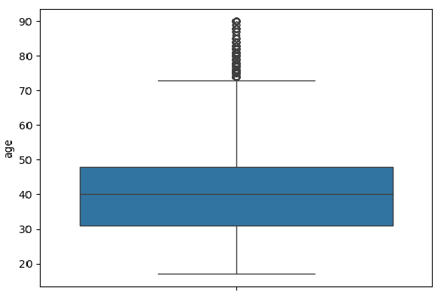
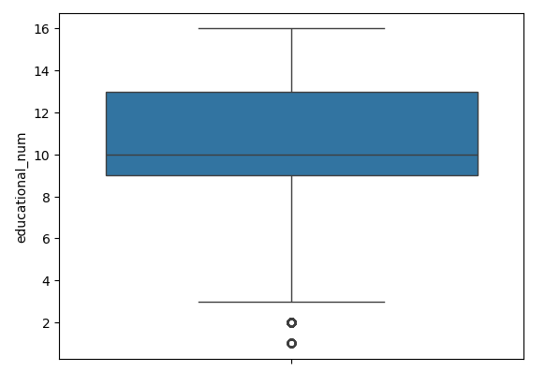
Outlier Box Plot on Numrical columns:

Slide 14
Class Imbalance Treatment:
The Dataset we are working with has class imbalance issue in income(Target):
High- 37155
Low- 11687
So we are using SMOTE to treat the imbalance issue , and the result are good.
High-37155
Low- 37155

Slide 15
Data Table 2:
Model Name | Accuracy | Precision | Recall | F1-Score
Logistic Reg | 66.034181 | 0.607243 | 0.683000 | 0.642898
Decision Tree | 85.318261 | 0.863290 | 0.847880 | 0.855516
Random Forest | 90.048446 | 0.900575 | 0.901659 | 0.901117
SVM | 58.794240 | 0.194441 | 0.938104 | 0.322116
KNN | 65.818867 | 0.593479 | 0.685445 | 0.636155
Naïve Bayes | 58.652940 | 0.222103 | 0.836858 | 0.351040
Conclusion : Random Forest is the top-performing model in terms of accuracy, precision, recall, and F1-score.

Slide 16
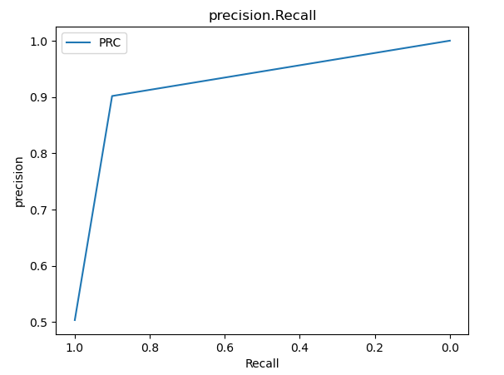
Graph of Best fitted model:
Best fitted model is Random Forest

Slide 17
Feature Selection :
We have used RFE(Recursive feature elimination) technique in feature selection.
From the data set unwanted feature like x ,workclass, education, occupation, race, gender, capital gain, capital loss, native country are removed.
Then we took the best model which is Random Forest and Recursive feature elimination technique.

Slide 18
Data Table -3
model_name | Accuracy | Precision | Recall | F1-score
RF | 83.965819 | 0.850060 | 0.834558 | 0.842238
xgboost | 85.372090 | 0.885073 | 0.834446 | 0.859014
From the above models xgboost is performing good.

Slide 19
Cross Validation
Reduces overfiting by ensuring that the model is evaluated on multiple data splits.
Provides a better estimate of model performing on unseen data.
We used Stratified k fold method where our accuracy is quite good.
Stratified CV accuracy:0.90

Slide 20
Draw Backs:
The Adult Occupation dataset has several limitations.
First, it contains missing or unknown values, such as the '?' in the workclass and occupation columns, which can lead to biased results if not handled properly.
Additionally, it lacks updated data, as the dataset is old and may not reflect current trends in the labor market.
The categorical variables are not numerically encoded, requiring additional preprocessing steps.
There may also be societal biases present in the data related to gender, race, and income, which could affect the fairness of any predictive models built using this dataset.

Slide 21
Thank you

